Slide 1
BIO SAFETY STANDARDS AND ETHICS (BT242AT) IV SEMESTER B E BASKET COURSE
Dr G Vijayakumar Dr PraveenKumar Gupta
Dr Trilok Chandran Dr A H Manjunatha Reddy
Dr Lingayya Hiremath Dr Narendra Kumar Sura
Dr Ajeet Kumar Sreevastava Dr H G Ashok Kumar
Dr H Raju Dr M Rajeswari

Slide 2

Introduction
After Covid – 19, we have improved our quality of living when compared to earlier.
Importance of hygiene
Personal healthcare
Food Habits and hygiene
Keeping these 3 as basic points we have designed the course on Bio safety standard and ethics. As an Engineer of any branch should know about Biosafety levels, Food safety and Bio ethics

Slide 3
Unit I & II
Biohazards, Bio safety levels and Bio safety cabinets and their types.
Various parameters considered for design of Biosafety cabinets
Biosafety guidelines of Government of India, GMOs (Genetically Modified Organisms) , LMOs (Living modified organisms)
Roles of Institutional Biosafety Committee, RCGM (Review committee on Genetic manipulation)
GEAC (Genetic Engg. Approval Committee) for GMO applications in food and agriculture.
Overview of National Regulations and relevant International Agreements including Cartagena Protocol.

Slide 4
Unit III
FSSAI (Food Safety and Standards Authority of India), Functions, License and rules.
Food Hygiene: General principles of food microbiology and overview of foodborne pathogens
sources of microorganisms in the food chain, Quality of foods, Microbial food spoilage and Foodborne diseases
Overview of beneficial microorganisms and their role in food processing and human nutrition, Food Analysis and Testing
General principles of food safety management systems, Hazard Analysis Critical Control Point (HACCP).

Slide 5
Unit IV & V
Food preservations, Processing, and Packaging.
Food Processing Operations, Principles, Good Manufacturing Practices
Overview of food preservation methods and their underlying principles including novel and emerging methods/principles and novel packaging materials
Food safety: Food Hazards, Food Additives, Food Allergens Drugs, Hormones, and Antibiotics in
Animals. Factors That Contribute to Foodborne Illness, Consumer Lifestyles and Demand, Food
Production and Economics, History of Food Safety, The Role of Food Preservation in Food Safety.
Ethics: Clinical ethics, Health Policy, Research ethics, ethics on Animals.

Slide 6


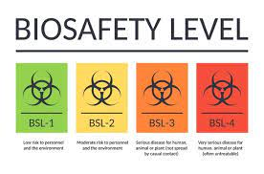
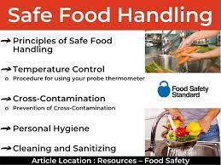
Thank you for any queries pl contact vijayakg@rvce.edu.in mobile no 9886272998 trilokc@rvce.edu.in mobile no 9591519849

Slide 7
Biological hazards
Biological hazards, also known as biohazards, refer to biological materials (microorganisms, plants, animals, or their byproducts) that pose a threat to the health of living organisms, primarily that of humans.
This can include medical waste or samples of a microorganism, viruses, or toxins (from a biological source) that can affect human health.
Potential biohazards can be found anywhere – at your job, in your doctor’s office, in your children’s classrooms – and should be handled with extreme caution.

Slide 8
Types of biological hazards
Viruses, such as Coronavirus (COVID-19) and Japanese encephalitis.
Toxins from biological sources.
Spores.
Fungi.
Pathogenic micro-organisms.
Bio-active substances

Slide 9
What are some biohazard examples?
Human blood and blood products. This includes items that have been affected by blood and other body fluids or tissues that contain visible blood.
Animal waste. Animal carcasses and body parts, or any bedding material used by animals that are known to be infected with pathogenic organisms.
Human body fluids. Semen, cerebrospinal fluid, pleural fluid, vaginal secretions, pericardial fluid, amniotic fluid, saliva, and peritoneal fluid.
Microbiological wastes. Common in laboratory settings, examples of microbiological wastes include specimen cultures, disposable culture dishes, discarded viruses, and devices used to transfer or mix cultures.
Pathological waste. Unfixed human tissue (excluding skin), waste biopsy materials, and anatomical parts from medical procedures or autopsies.
Sharps waste. Needles, glass slides and cover slips, scalpels, and IV tubing that has the needle attached.

Slide 10
How body is effected
Most biological hazards can cause disease in humans, from the common cold to life-threatening diseases. They can also cause other effects, such as poisonings, or provoke an allergic response.
Chronic health conditions are long-term conditions and diseases lasting 3 months or longer. They may not have a cure.
Acute conditions - sometimes called poisonings - are adverse effects from either a single dose of a substance, multiple doses given within 24 hours or an inhalation exposure of 4 hours.

Slide 11
Introduction to Bacteria and virus in human body
The human body is made of about 100 trillion cells. These cells are quite complex. Most have a nucleus
and many special parts.
Bacteria are much simpler. A bacterium is made of only one cell but has no nucleus. Bacteria are small;
each is about 1/100th the size of a human cell.
Bacteria are like fish swimming in the ocean of your body. As they swim around, they eat and reproduce
rapidly. One bacterium can become millions of bacterium in just a few hours.
Viruses are completely different. A virus is a particle of DNA or RNA with a special cover over it. When a
virus comes in contact with a living cell, it attaches to it. The virus injects its DNA or RNA into the cell.
The virus DNA or RNA takes over and uses the cell to make more viruses.
Eventually the cell dies and bursts open spewing millions of new viruses into the body of its victim. Each
new virus particle can infect another cell

Slide 12
Bacteria
Bacteria are microscopic, single-celled organisms that can live anywhere. They are classified as prokaryotes, a simple internal structure that lacks a nucleus. They contain DNA that either floats freely in a twisted, thread-like mass called the nucleoid, or in separate, circular pieces called plasmids. Not all bacteria are harmful, some are necessary for healthy body function.
Bacteria are classified according to a range of criteria including the nature of their cell walls (i.e. gram positive or negative), their shape (i.e. round, cylindrical or spiral), or by differences in their genetic makeup.
Most bacteria multiply by a process called binary fission – a single bacterial cell makes a copy of its DNA, doubles its cellular content, and then splits apart pushing the duplicated material out creating two identical ‘daughter’ cells. Bacteria can introduce variation into themselves by integrating additional DNA, often from their surroundings, into their genome.
Bacteria can cause harm by directly invading and damaging tissue, others produce powerful chemicals known as toxins, which damage cells. Antibiotics are commonly used to treat bacterial infections, but some strains of
Bacteria have become resistant to antibiotics, making them difficult to treat. Antibiotic resistance can be transferred between bacterial strains through conjugation
Bacteria size will varies from 0.05–0.2 μm

Slide 13
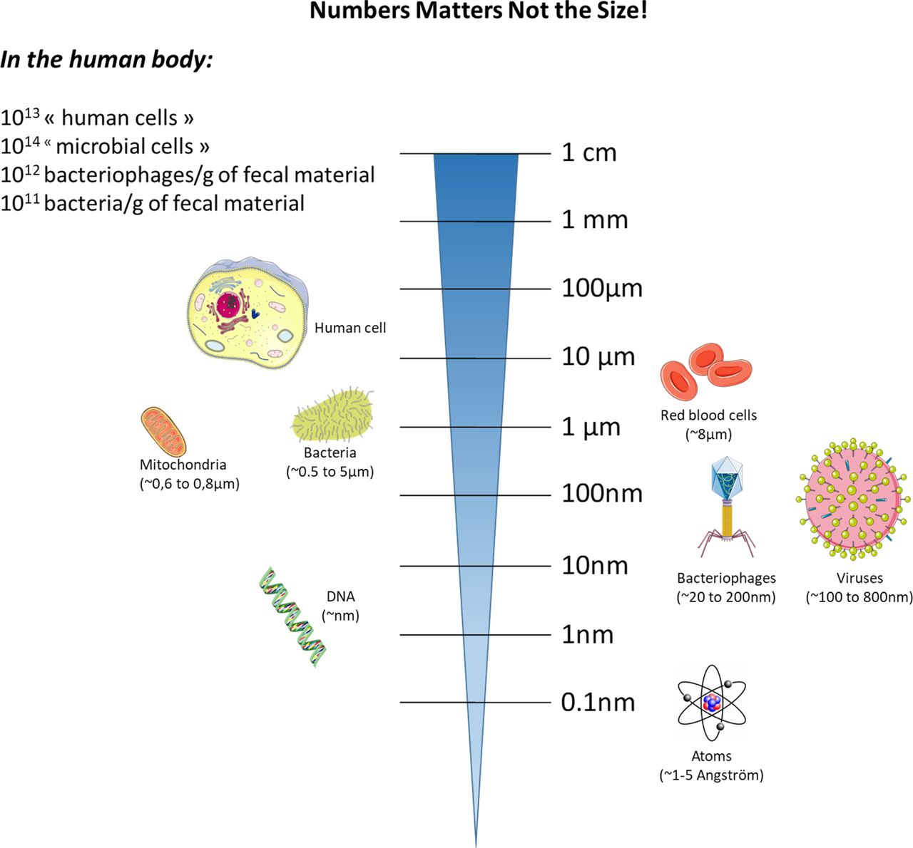

Slide 14
Bacteria
Bacteria | Name of infection or illness
Salmonella enterica | Diarrheal illness
Vibrio cholerae | Cholera
Shigella dysenteriae | Dysentery
Mycobacterium tuberculosis | Tuberculosis (TB)
Pseudomonas aeruginosa and Burkholderia cepacia | Pneumonia
Legionella pneumophila | Legionnaire’s disease
Chlamydia psittaci | Psittacosis
Staphylococcus aureus | Skin infections, endocarditis and osteomyelitis
Leptospira | Leptospirosis, also called Weil's disease
This is a common microscopic organism, which can multiply rapidly and build-up, causing infection.
Most bacteria are harmless. Many types grow naturally on the human body and mucus membranes.
Bacteria can be found on all workplace surfaces, in the soil and growing in various substances used by workers.
Bacteria needs certain conditions to replicate, such as: Warmth, (5 to 60C), Moisture, Food (Nutrients, including
foodstuffs, biological metalworking fluids and more), pH (7), Time (20 minutes).

Slide 15
Viruses
Viruses are different to bacteria as they are the smallest microbes.
Size of the viruses ranges from 20nm to 400 nm
A virus is a core genetic material, either Deoxyribonucleic acid (DNA) or Ribonucleic acid (RNA), covered by a protective coat of protein.
Viruses replicate inside other living cells, they can latch on to host cells, taking over their functions. The infected cell can infect new cells when stimulated.
Viruses are different to bacteria as they are the smallest microbes. A virus is a core genetic material, either Deoxyribonucleic acid (DNA) or Ribonucleic acid (RNA), covered by a protective coat of protein.
Viruses replicate inside other living cells, they can latch on to host cells, taking over their functions. The infected cell can infect new cells when stimulated.
Viruses can cause several diseases in more advanced cell structures. Examples include:
chicken pox, cold, COVID 19, ebola, flu, hepatitis, herpes simplex virus (HSV), measles, mumps, polio, rabies, rubella, smallpox.

Slide 16
Toxins from biological sources
Toxins are a subset of poison produced by living organisms. Poisons are any substance that can cause harm to an organism if enough has been absorbed, this can be either through ingestion, inhalation, or direct contact.
Many organisms produce toxins either as a defence mechanism or for predation, they tend to be produced by bacteria, fungi, plants, insect, and animals.
The five most deadly toxins are:
botulinum toxin A, from the bacteria clostridium botulinum
tetanus toxin A, from the bacteria clostrifium tetani
diphtheria toxin, from the bacteria corynebacterium diphtheriae
muscarine, from the mushroom amanita muscaria
bufotoxin, from the common toad genus bufo.
Toxins can present in a variety of workplace settings. Venomous insects such as bees and wasps can nest in any number of workplace buildings and can potentially sting workers. In many countries, snakes and spiders are highly venomous, so can be a threat to workers.

Slide 17
Anaphylaxis
A severe allergic reaction which can be fatal. This usually occurs in response to almost any foreign substance. Common triggers include:
toxins from insect bites
Stings
Food
Medicines.
Anaphylaxis is a common medical emergency and a life-threatening acute hypersensitivity reaction. It can be defined as a rapidly evolving, generalized, multi-system allergic reaction. Without treatment, anaphylaxis is often fatal due to its rapid progression to respiratory collapse.

Slide 18
Long-term diseases, also called chronic diseases
Local diseases target one part (Lungs) of the body. An example of a local disease is hepatitis B (HBV). This can be transmitted into the body through contact with infectious body fluids such as blood, vaginal secretions or semen.
Systemic diseases affect many parts of the body or the whole body. They can start as a local disease and progress to systemic disease. For example, pneumonia may begin in one lung or both lungs but then spread throughout the body into a potentially life-threatening condition.
Parasitic diseases are infectious diseases caused or transmitted by a parasite. A common example of parasitic disease is toxoplasmosis. Infection usually occurs from:
eating undercooked contaminated meat, exposure to infected cat poo, or mother-to-child transmission in pregnancy.
Cancer
Carcinogens are substances that can cause cancer. Cancer is an uncontrolled growth of abnormal cells in the body. Some new cases of cancer could be attributed to agents such as human papillomavirus (HPV), helicobacter pylori, hepatitis B and C viruses.
Psychological conditions
There is a possible connection between infections and the development of disorders such as schizophrenia, depression and bipolar disorder. A theory is that infection may influence the brain with infective agents, altering the central nervous system.
Toxins (long-term)
Some toxins can have long-term effects. They affect people in different ways, from mild illness to death. For example, there are several types of toxins produced by harmful algae, which in large quantities can form toxic blooms. These can be responsible for causing:
respiratory irritation and distress, diarrhoea, vomiting, numbness, dizziness, paralysis, death.
Allergies
Allergies are long-term conditions that are not life threatening but cause localised tissue inflammation. Some biological hazards can cause hypersensitivity, which is an over reaction by the immune system to an allergen. Examples include:
pollens from plants, viruses, bacteria, animals and birds.

Slide 19
Biosafety levels
What Are Biosafety Levels?
Biological safety levels — are a series of protections specific to autoclave related activities that take place in biological labs. Biosafety levels are individual safeguards designed to protect laboratory personnel, as well as the surrounding environment and community.
Each biosafety level — BSL-1 to BSL-4 — is defined based on the following:
Risks related to containment
Severity of infection
Transmissibility
Nature of the work conducted within the lab
Origin of the microbe
Agent in question
Route of exposure

Slide 20
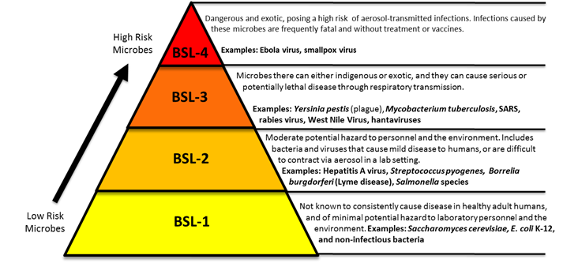

Slide 21
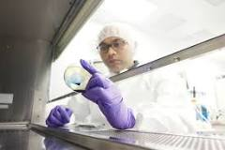
Biological safety cabinets (BSCs)
Biological safety cabinets (BSCs) are used to protect personnel, products and the environment from exposure to biohazards and cross contamination during routine procedures.
BSCs are designed to handle hazardous pathogenic materials, among other biohazards, and are used regularly in various types of laboratories ranging from basic research to high containment.
Every BSC is categorized by a specific biosafety class: Class I, Class II or Class III.

Slide 22
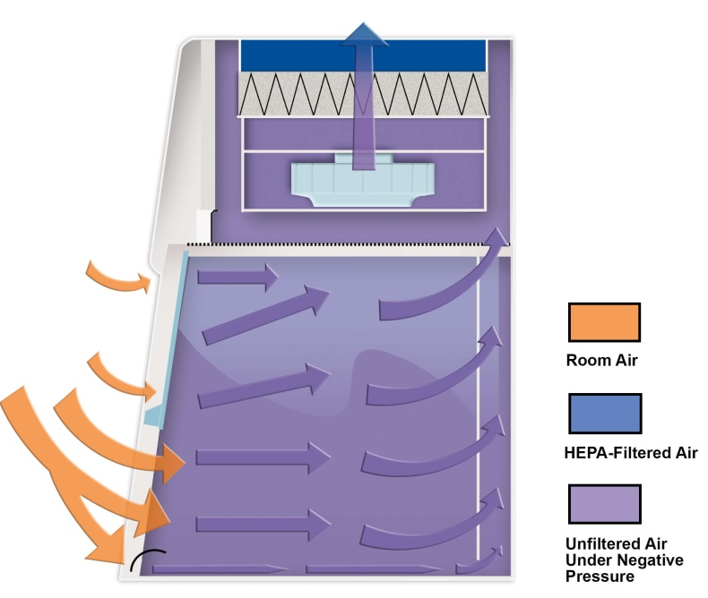
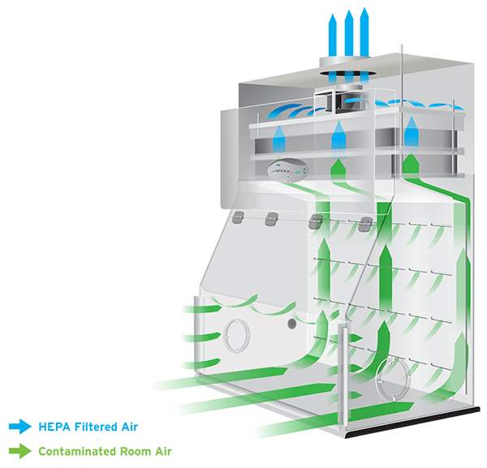
Biosafety Cabinet Class I
The Class I Biosafety Cabinet (BSC) provides personnel and environmental protection, but no product protection.
It is similar in air movement to a chemical fume hood but has a limited fixed work access opening, and the exhaust air must be HEPA filtered to protect the environment.
However, to be classified as a Class I BSC, the inward flow of air must be maintained at a minimum inflow velocity of 75 linear feet per minute (FPM) (0.38 m/s) through the front access opening.
The Class I BSC is designed for general microbiological research with low and moderate-risk agents or non-sterile hazardous drug compounding in the pharmacy.
The Class I cabinet may be recirculated back into the laboratory environment if no volatile chemicals a present.
A Class I CVE may be recirculated back into the pharmacy if exhausted air passes through redundant (two) HEPA filters as per USP 797 and USP 800.

Slide 23
Class II cabinet
It is defined as a ventilated cabinet for personnel, product and environmental protection, often used for microbiological work or sterile pharmacy compounding.
Class II BSCs are designed with an open front with inward airflow (personnel protection), downward HEPA-filtered laminar airflow (product protection) and HEPA-filtered exhaust air (environmental protection).
These cabinets are further differentiated by types based on construction, airflow and how they interface with exhaust systems — A1, A2, B1, B2 and C1.
All Class II BSCs require all biologically contaminated ducts and plenums to be under negative pressure or surrounded by negative pressure ducts and plenums. This provides a fail-to-safe feature that protects the user even in the event of a plenum failure.
Type B2 cabinets take this a step further, requiring all biologically contaminated ducts and plenums to be under negative pressure or surrounded by directly exhausted negative pressure ducts and plenums.
Type C1 cabinets provide even more protection by maintaining containment from biological and chemical hazards during building exhaust failures.

Slide 24
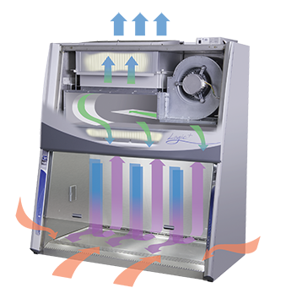
Class II, Type A2
A Class II, Type A2 biosafety cabinets are the most common type of BSC used today.
Must maintain a minimum average inflow velocity of 100 fpm through the sash opening.
Approximately 60% to 70% of the contaminated air is recycled and pushed back into the workstation in the chamber through the downflow HEPA filter, while the remaining 30% to 40% is exhausted through the exhaust HEPA filter.
The recirculated, HEPA-filtered downflow air (Laminar flow) creates an ISO 5 environment within the work area that protects the samples from external contaminants.
When limited amounts of volatile chemicals are required, both NSF 49 and BMBL advise the unit shall be connected to an external exhaust system via a canopy style exhaust connection that will provide an audible and visual alarm within 15 seconds of an exhaust failure.
It’s advised to never use a direct-connect or hard ducted connection when working with hazardous chemicals. Canopy vented Type A2 cabinets may be used for work with limited amounts of volatile chemicals if deemed appropriate by a chemical risk assessment.
However, if hazardous, volatile chemicals are to be used within the cabinet, along with the microbiological work, exhaust must be released into the atmosphere through the direct duct system..

Slide 25
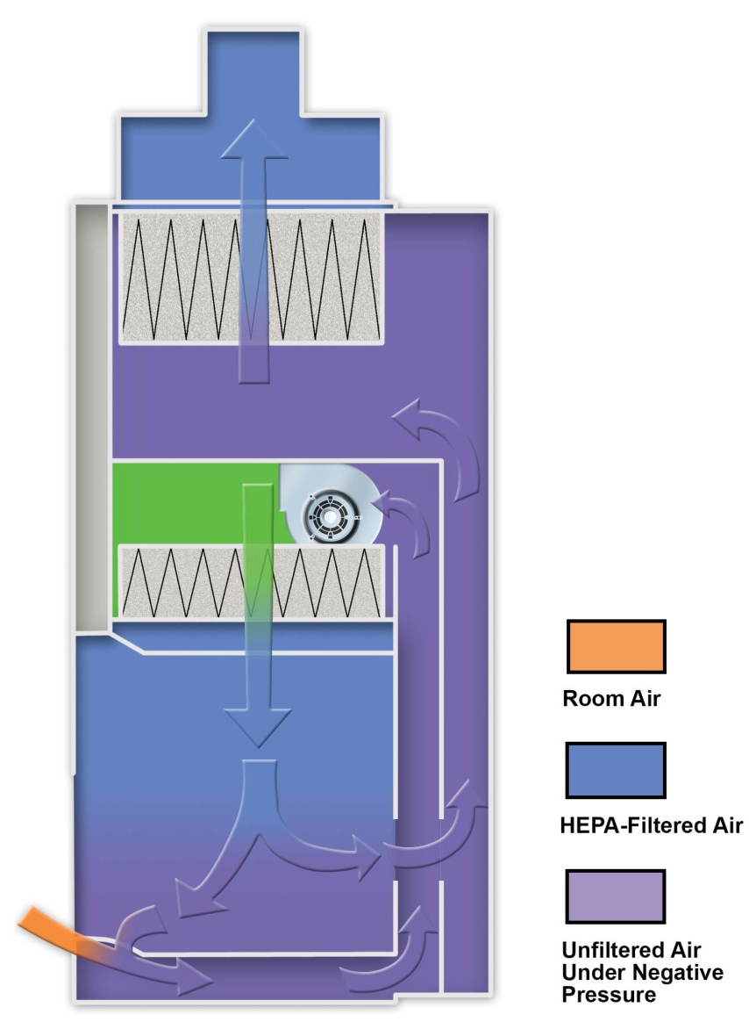
Class II, Type B1
Class II, Type B1 biosafety cabinets must maintain a minimum average inflow velocity of 100 fpm through the sash opening and must be connected to a building exhaust system.
They have HEPA-filtered downflow air composed mostly of uncontaminated recirculated inflow air and exhaust most of the contaminated downflow air through a dedicated duct after passing through a HEPA filter.
Type B1 cabinets are safe for work involving limited amounts of volatile chemicals and trace amounts of radionuclides, as long as the work is done in the rear portion of the cabinet behind the smoke split.
The rear portion is not marked or well-defined, and is ever-changing as the BSC’s filters load, making this type of cabinet unsafe for all but the most well-trained users.

Slide 26
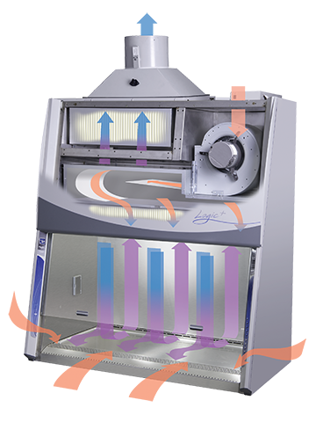
Class II, Type B2
A Class II, Type B2 cabinets must maintain a minimum average inflow velocity of 100 fpm through the sash opening and require a dedicated exhaust system and dedicated remote blower for each cabinet.
All of the contaminated airflow (100%) in a Type B2 cabinet is externally exhausted which means the air drawn into the cabinet is 100% exhausted into the atmosphere.
They have HEPA-filtered downflow air drawn from the laboratory (not recirculated from the cabinet exhaust) and exhaust all inflow and downflow air out to the atmosphere after filtration through a HEPA filter.
Type B2 cabinets are suitable for work involving limited amounts of volatile chemicals and trace amounts of radionuclides as an adjunct to microbiology applications.
Although Type B2 BSCs offer protection when using higher volumes of chemicals within the cabinet, they require complicated exhaust configurations and consume large amounts of air to function.
As a result, Type B2 cabinets have the highest installation and operational costs of any Class II BSC.

Slide 27
Class III
A Class III cabinet is defined as a totally enclosed, ventilated cabinet with leak-tight construction and attached rubber gloves for performing operations in the cabinet.
These cabinets have a transfer chamber with interlocked doors that allow for sterilization of materials before entering/exiting the glove box. Materials can also be taken in and out through a dunk tank filled with a disinfecting solution.
The cabinet is maintained under negative pressure and supply air is drawn in through HEPA filters. The exhaust air is treated with either double HEPA filtration or single HEPA filtration followed by air incineration and then exhausted outside.
They are most commonly found in BSL 3 and BSL 4 laboratories, dubbed cabinet laboratories.

Slide 28
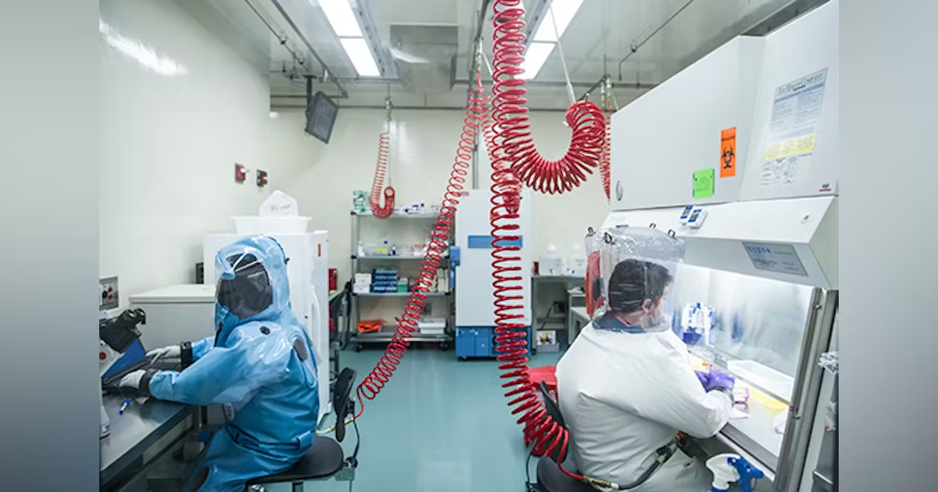
Class IV
BSL-4. BSL-4 builds upon the containment requirements of BSL-3 and is the highest level of biological safety. There are a small number of BSL-4 labs in the United States and around the world. The microbes in a BSL-4 lab are dangerous and exotic, posing a high risk of aerosol-transmitted infections.
Biohazard Level 4 usually includes dangerous viruses like Ebola, Marburg virus, Lassa fever, Bolivian hemorrhagic fever, and many other hemorrhagic viruses found in the tropics.

Slide 29
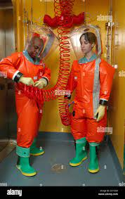
Class IV
In addition to biosafety level 3 considerations, biosafety level 4 laboratories must follow these safety protocols:
Personnel must change clothing before entering the facility and shower upon exiting
All materials must be decontaminated before leaving the facility
Personnel must wear the PPE from lower BSL levels, as well as a full-body, air-supplied, positive pressure suit
Access to a Class III biological safety cabinet
BSL-4 labs are extremely isolated, often located in an isolated and restricted zone of a building or in a separate building entirely.
BSL-4 labs also feature a dedicated supply of exhaust air, as well as vacuum lines and decontamination systems.

Slide 30
